Slide 1
ATM SERVICE USING EMULATOR 8086
REVIEW -2

Slide 2
Team Members
N. SURYA PRAKASH 19BPS1052
M.HANUMAN SAI 19BPS1066
GOPU.VIJAY 19BPS1078

Slide 3
Flowchart of execution of ATM Simulation:
START
Enter Password
Banking options
Balance Enquiry
Money withdraw
Transfer Money
Cancel Transaction

Slide 4
PROJECT PHASE DIVISION PHASE 1 : PASSWORD CHECK PHASE 2 : DISPLAY BANKING OPTIONS PHASE 3 : BALANCE ENQUIRY PHASE 4 : MONEY WITHDRAW PHASE 5 : TRANSFER MONEY PHASE 6 : CANCEL TRANSACTION

Slide 5
PHASE 1 : CODE FOR PASSWORD CHECK
DATA SEGMENT MSG1 DB 10,13,’ENTERED PASSWORD : $’ MSG2 DB 10,13,’YOU HAVE ENTERED WRONG PASSWORD !!! $’ MSG3 DB 10,13,’YOU HAVE ENTERED CORRECT PASSWORD ! $’ MSG4 DB 10,13,’PASSWORD LENGTH IS NOT EQUAL $’
STR1 DB “NITIN”
P1 LABEL BYTE M1 DB 0FFH L1 DB ? P11 DB 0FFH DUP (‘$’) DATA ENDS

Slide 6
……
DISPLAY MACRO MSG MOV AH,9 LEA DX,MSG INT 21H ENDM
CODE SEGMENT ASSUME CS:CODE,DS:DATA START: MOV AX,DATA MOV DS,AX
DISPLAY MSG1

Slide 7
….
LEA DX,P1 MOV AH,0AH INT 21H
CMP L1,5 JNE NOTEQUAL
LEA SI,STR1 LEA DI,P11
MOV CX,5 CHECK: MOV AL,[SI] CMP [DI],AL JNE NOPASWD

Slide 8
……..
INC SI INC DI LOOP CHECK
DISPLAY MSG3 JMP EXIT
NOTEQUAL: DISPLAY MSG4
NOPASWD: DISPLAY MSG2 JMP EXIT
EXIT: MOV AH,4CH INT 21H CODE ENDS END START

Slide 9
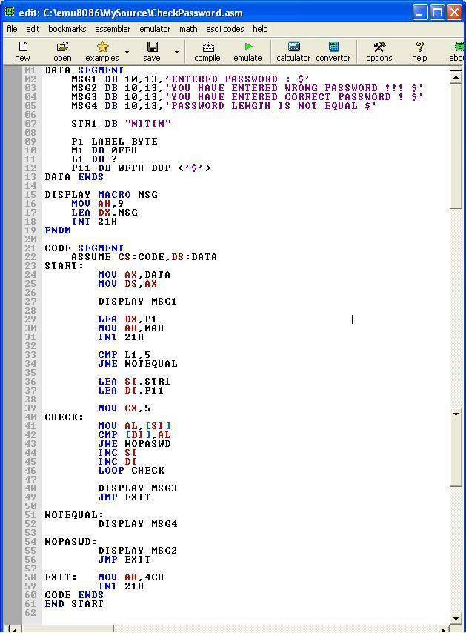
SCREENSHOT OF THE CODE IN EMULATOR

Slide 10
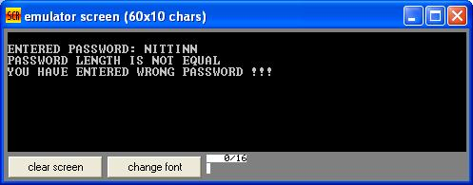
AFTER EXECUTION

Slide 11
PHASE 2 : DISPLAY BANKING OPTIONS
This is the phase 2 of our project . Here, In this Phase 2 after entering the correct password ,Three options will display the user can use of their choice.
1. BALANCE ENQUIRY
2. MONEY WITHDRAW
3. TRANSFER MONEY
4. CANCEL TRANSACTION

Slide 12
CODE FOR DISPLAY OF BANKING OPTIONS
;Options Phase
wel db 10,13," Welcome to Your Account $"
bal db 10,13,10,13,"1. Balance Inquiry $"
with db 10,13,"2. Money Withdraw $"
trans db 10,13,"3. Transfer Money $"
ex db 10,13,"4. Exit $"
bac db 10,13,"1. Back$"
ext db 10,13,"2. Exit$

Slide 13
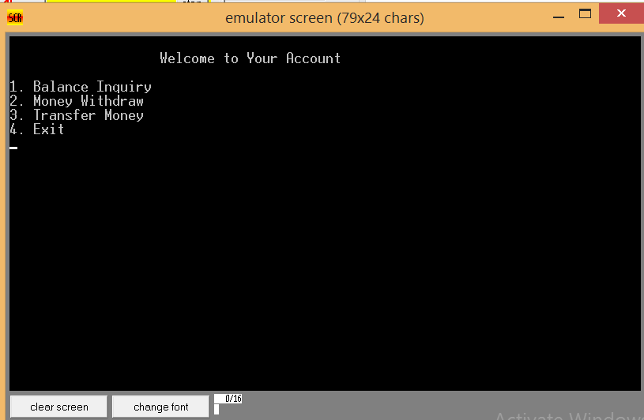
AFTER EXECUTION

Slide 14
PHASE 3 : BALANCE ENQUIRY
PART 1 : TOTAL BALANCE BEFORE TRANSACTION
CODE :-
totalbal db 10,13,"Your Total Balance is: 25,000 USD $"
availablebal db 10,13,"Your Available Balance is: 24,900 USD $"
Since Minimum Balance should maintain in the particular account
So, ATM will display two types of balances Total and Available balance

Slide 15
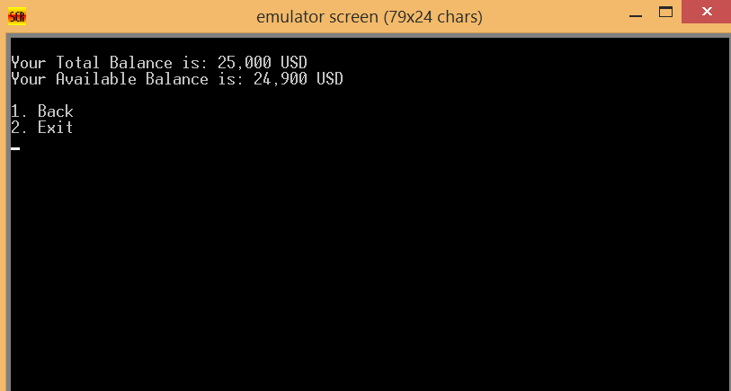
AFTER EXECUTION

Slide 16
PHASE 3 : BALANCE ENQUIRY
PART 2 : TOTAL BALANCE AFTER TRANSACTION
;Balance info
t1 db 10,13,"Your Total Balance is: 24,500 USD $"
av1 db 10,13,"Your Available Balance is: 24,400 USD $"
t2 db 10,13,"Your Total Balance is: 24,000 USD $"
av2 db 10,13,"Your Available Balance is: 23,900 USD $"
t3 db 10,13,"Your Total Balance is: 22,000 USD $"
av3 db 10,13,"Your Available Balance is: 21,900 USD $"
t4 db 10,13,"Your Total Balance is: 20,000 USD $"
av4 db 10,13,"Your Available Balance is: 19,900 USD $"

Slide 17
t5 db 10,13,"Your Total Balance is: 15,000 USD $"
av5 db 10,13,"Your Available Balance is: 14,900 USD $"
t6 db 10,13,"Your Total Balance is: 10,000 USD $"
av6 db 10,13,"Your Available Balance is: 9,900 USD $"
t7 db 10,13,"Your Total Balance is: 5,000 USD $"
av7 db 10,13,"Your Available Balance is: 4,900 USD $"

Slide 18
;Account Balance Cheek Level
blance:
mov ah,0x00
mov al,0x03
int 0x10
mov ah,9
lea dx,totalbal
int 21h
mov ah,9
lea dx,availablebal
int 21h
jmp option

Slide 19
PHASE 4 : MONEY WITHDRAW
CODE :
;Money Withdraw Options
fivehun db 10,13,"1. 500 USD$"
one db 10,13,"2. 1,000 USD$"
three db 10,13,"3. 3,000 USD$"
five db 10,13,"4. 5,000 USD$"
ten db 10,13,"5. 10,000 USD$"
fiften db 10,13,"6. 15,000 USD$"
tweenty db 10,13,"7. 20,000 USD$"

Slide 20
;Money Withdraw Level
withdraw:
mov ah,0x00
mov al,0x03
int 0x10
mov ah,9
lea dx,new
int 21h
mov ah,9
lea dx,wdamount
int 21h
;Money Withdraw Option Display
mov ah,9
lea dx,fivehun
int 21h
mov ah,9
lea dx,one
int 21h

Slide 21
mov ah,9
lea dx,three
int 21h
mov ah,9
lea dx,five
int 21h
mov ah,9
lea dx,ten
int 21h
mov ah,9
lea dx,fiften
int 21h
mov ah,9
lea dx,tweenty
int 21h

Slide 22
mov ah,9
lea dx,new
int 21h
mov ah,1
int 21h
mov bl,al
;Input Condition Cheek
cmp bl,49
je pross1
cmp bl,50
je pross2
cmp bl,51
je pross3
cmp bl,52
je pross4

Slide 23
cmp bl,53
je pross5
cmp bl,54
je pross6
cmp bl,55
je pross7
jmp err
;Option 1
pross1:
mov ah,0x00
mov al,0x03
int 0x10
mov ah,9
lea dx,success
int 21h
mov ah,9
lea dx,new
int 21h
mov ah,9
lea dx,new
int 21h

Slide 24
mov ah,9
lea dx,t1
int 21h
mov ah,9
lea dx,av1
int 21h
mov ah,9
lea dx,new
int 21h
jmp option
;Option 2
pross2:
mov ah,0x00
mov al,0x03
int 0x10
mov ah,9
lea dx,success
int 21h
mov ah,9
lea dx,new

Slide 25
int 21h
mov ah,9
lea dx,new
int 21h
mov ah,9
lea dx,t2
int 21h
mov ah,9
lea dx,av2
int 21h
mov ah,9
lea dx,new
int 21h
jmp option

Slide 26
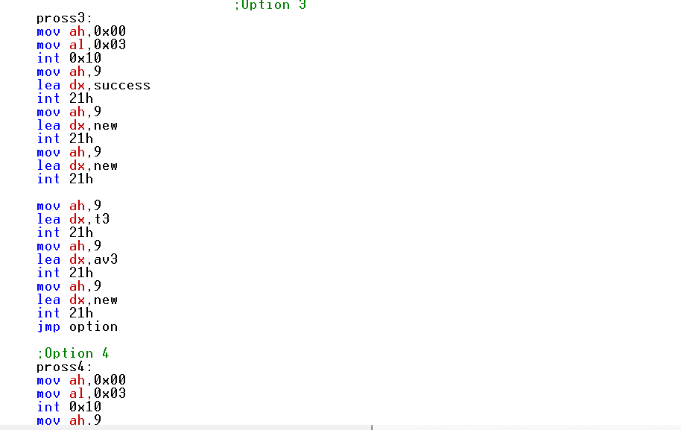

Slide 27
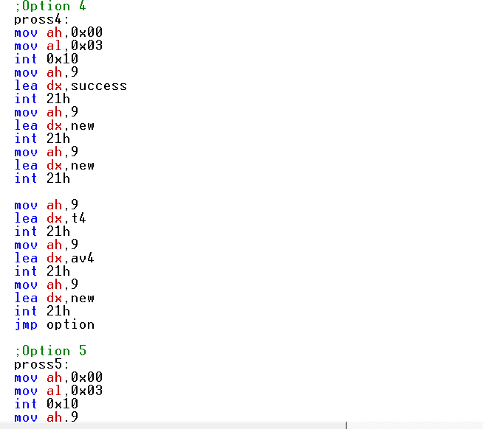

Slide 28
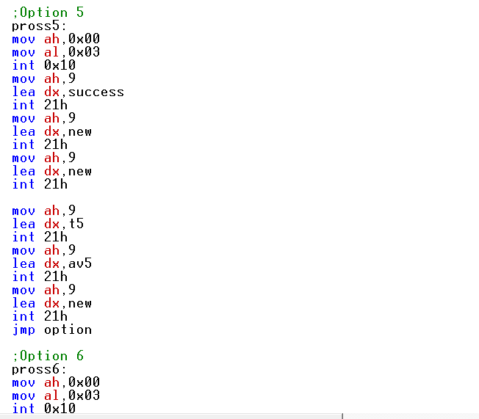

Slide 29
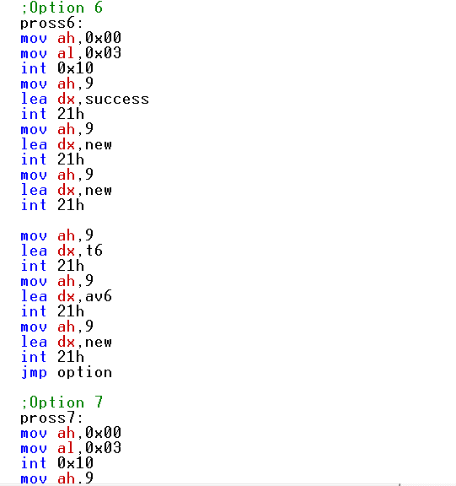

Slide 30
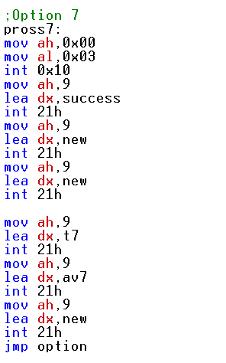

Slide 31
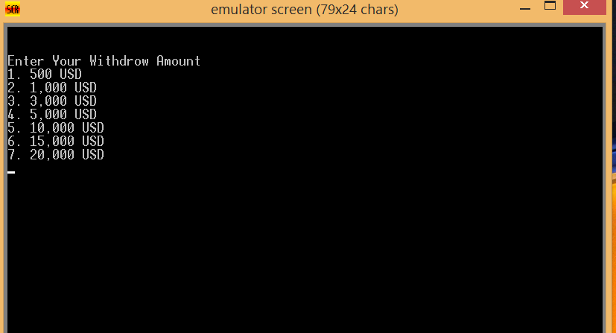
AFTER EXECUTION

Slide 32
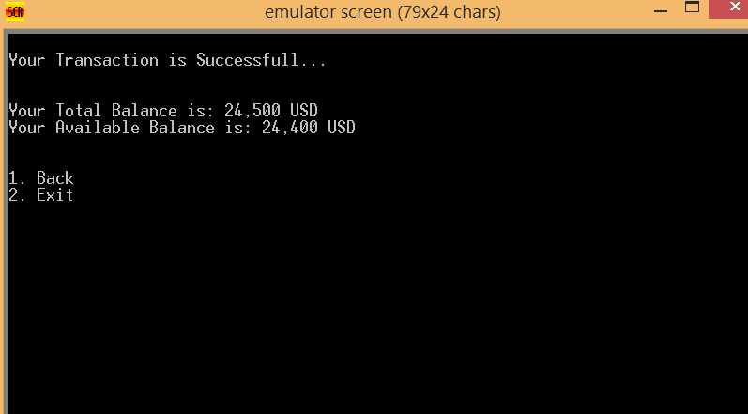
AFTER TRANSACTING 500 USD

